Slide 1
npm i react-router-dom@6 bootstrap
import React from 'react'
function Home() {
return (
<div>
<div className="card-body">Home</div>
</div>
)
}
export default Home

Slide 2
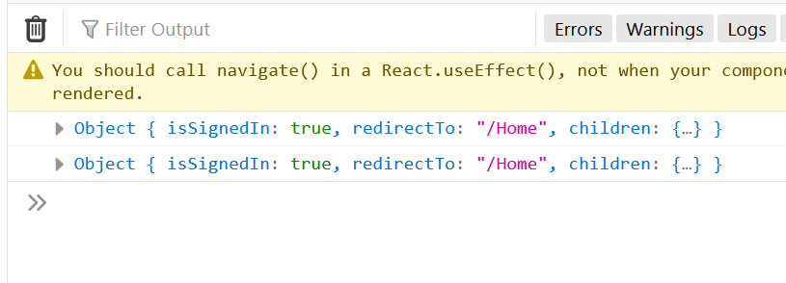
A <Navigate> element changes the current location when it is rendered. It's a component wrapper around useNavigate, and accepts all the same arguments as props.
import React from 'react'
function Dashboard() {
return (
<div>
<div>Dashboard</div>
</div>
)
}
export default Dashboard
Having a component-based version of the useNavigate hook makes it easier to use this feature in a React.Component subclass where hooks are not able to be used.
import React from 'react'
import { useNavigate } from 'react-router-dom'
function Protected({ isSignedIn, children }) {
const navigate=useNavigate();
if (!isSignedIn) {
return navigate("/");
}
return children
}
export default Protected
Object destructuring

Slide 3
import './App.css';
import { useState } from 'react';
import Home from './Home';
import Dashboard from './Dashboard';
import Protected from './Protected';
import {BrowserRouter,Link,Routes,Route ,Outlet} from 'react-router-dom';
function App() {
const [isSignedIn, setIsSignedIn] = useState(null);
const signin = () => { setIsSignedIn(true)
}
const signout = () => {
setIsSignedIn(false)
}
return (
<div>
<h2>React Protected Routes Example</h2>
<BrowserRouter>
<Link to='/home'>Home</Link> { ' | ' }
<Link to='/dashboard'>Dashboard</Link>
{ isSignedIn ? (
<div>
<button onClick={signout}> Sign out </button> </div>
) : (
<div>
<button onClick={signin}> Sign in </button> </div>
)}
<Routes>
<Route path="/" element={<Home />}/>
<Route path="/home" element={<Home />} />
<Route path="/dashboard" element={
<Protected isSignedIn={isSignedIn}> <Dashboard /> </Protected>
} />
</Routes>
</BrowserRouter>
</div>
);
}
export default App;
{isSignedIn:isSignedIn}

Slide 4
